Slide 1
INFO 250 Information Visualization
7B Dimensionality Reduction
tSNE
UMAP

Slide 2
Dimensionality Reduction
UMAP (Uniform Manifold Approximation and Projection) and t-SNE (t-distributed Stochastic Neighbor Embedding) are both popular nonlinear dimensionality reduction techniques used for visualizing high-dimensional data in a lower-dimensional space.

Slide 3
UMAP vs t-SNE
Scalability: UMAP is generally faster and more scalable than t-SNE, especially for larger datasets. This is because UMAP uses a different algorithmic approach that is more efficient than t-SNE.
Parameter sensitivity: UMAP is less sensitive to its hyperparameters than t-SNE. This means that UMAP often performs well with default parameter settings, whereas t-SNE requires more tuning to achieve optimal results.
Preserving global structure: UMAP is designed to preserve the global structure of the data, which means that it tries to preserve both local and global relationships between data points. t-SNE, on the other hand, is primarily focused on preserving the local structure of the data, which means that it may not always capture the global relationships between data points. (Note: This is controversial and inconclusive).
Stability: UMAP is generally more stable than t-SNE, which means that it tends to produce more consistent results across multiple runs with different random seeds.
In summary, UMAP is often faster, more scalable, and more stable than t-SNE, and it may be a better choice for larger datasets or when the global structure of the data is important. However, t-SNE may be a better choice when the local structure of the data is more important, and it may produce more visually appealing embeddings in some cases. Ultimately, the choice between UMAP and t-SNE will depend on the specific requirements of the analysis and the characteristics of the data being visualized.

Slide 4

UMAP does not preserve global structure any better than t-SNE when using the same initialization https://doi.org/10.1101/2019.12.19.877522
Becht et al. [3] argued that UMAP is preferable to t-SNE because it better preserves the global structure of the data and is more consistent across runs.
Here we show that this alleged superiority of UMAP can be entirely attributed to different choices of initialization in the implementations used by Becht et al.: t-SNE implementations by default used random initialization, while the UMAP implementation used a technique called Laplacian eigenmaps [4] to initialize the embedding.
We show that UMAP with random initialization preserves global structure as poorly as t-SNE with random initialization, while t-SNE with informative initialization performs as well as UMAP with informative initialization.
Hence, contrary to the claims of Becht et al., their experiments do not demonstrate any advantage of the UMAP algorithm per se, but rather warn against using random initialization.

Slide 5
Initialization is critical for preserving global data structure in both t-SNE and UMAP https://www.nature.com/articles/s41587-020-00809-z
Becht et al.4 argued that UMAP is preferable to t-SNE because it better preserves the global structure of the data and is more consistent across runs. Here we show that this alleged superiority of UMAP can be entirely attributed to different choices of initialization in the implementations used by Becht et al.: the t-SNE implementations by default used random initialization, while the UMAP implementation used a technique called Laplacian eigenmaps (LE)5 to initialize the embedding. We show that UMAP with random initialization preserves global structure as poorly as t-SNE with random initialization, while t-SNE with informative initialization performs as well as UMAP with informative initialization. On the basis of these observations, we argue that there is currently no evidence that the UMAP algorithm per se has any advantage over t-SNE in terms of preserving global structure. We also contend that these algorithms should always use informative initialization by default. At the core of both t-SNE and UMAP are loss functions that make similar points attract each other and push dissimilar points away from each other. Both algorithms minimize their loss functions by using gradient descent. Gradient descent begins with some initial configuration of points, and with each iteration the points are moved to decrease the loss function. The specific implementations of these algorithms used by Becht et al. differed in how the initial configuration of points was chosen: the t-SNE implementations placed the points randomly, whereas the UMAP implementation used LE5, an algorithm that can often achieve globally accurate embedding on its own6. The effect of this difference on how well the two algorithms preserve global structure was not discussed or investigated by Becht et al. We can illustrate the importance of initialization for both algorithms using a simple toy dataset (Fig. 1). We sampled n = 7,000 points from a circle with some added Gaussian noise and used UMAP and t-SNE to construct an embedding. We kept all parameters for both algorithms at their default values and only changed the initialization. The t-SNE algorithm with random initialization produced a knot; UMAP with random initialization produced a tangled web with multiple tears. In both cases, the global structure was evidently not preserved; indeed, gradient descent in t-SNE and UMAP only pulls close neighbors together and is not much influenced by the global arrangement of points. At the same time, LE recovers the original circle for this toy dataset and, when used for initialization, strongly improves the UMAP result. A method often recommended for initialization in t-SNE is principal component analysis (PCA)2. Here PCA also recovers the original circle and strongly improves the t-SNE result. In both cases, only with informative initialization can UMAP and t-SNE produce a faithful representation of the closed one-dimensional manifold—the circle. Using the code published by Becht et al., we analyzed the separate effects of initialization and algorithm on their results by adding UMAP with random initialization and t-SNE (using FIt-SNE7) with PCA initialization to the benchmarking comparison. Apart from the initialization, both algorithms were run with the same parameters as in Becht et al. We used all three datasets analyzed in the original publication (sample sizes from 320,000 to 820,000 cells)8–10. To quantify preservation of global structure, Becht et al. computed Pearson correlation between pairwise Euclidean distances in high-dimensional space and in the embedding. To quantify the reproducibility of the embedding, the authors embedded random subsamples of the data and measured the correlation of the coordinates of subsample embeddings with the coordinates of the full-dataset embeddings (up to symmetries around the coordinate axes). Our results show that t-SNE and UMAP with random initialization perform similarly poorly with regard to both metrics, whereas t-SNE and UMAP with PCA and LE initialization, respectively, perform similarly well (Table 1). See Extended Data Figs. 1–6 for the exact analogs of the original figures from Becht et al. Becht et al. wrote that their findings were “consistent with the idea” that UMAP performs “optimizations that are sensitive to global features of the data, thus reaching similar arrangements more consistently.” Our results show that this conclusion can be misleading: their findings were in fact not due to UMAP optimizations but rather to its initialization. We have recently argued that, for single-cell transcriptomic data, t-SNE with PCA initialization produces more meaningful embeddings than t-SNE with random initialization2. The findings of Becht et al., when interpreted correctly, also underscore the importance of using informative initialization and suggest that it should be used as the default option in t-SNE and UMAP implementations. PCA initialization has always been the default in openTSNE11, a Python reimplementation of FIt-SNE, and FIt-SNE v.1.2 now also uses it by default. OpenTSNE v.0.4 now also supports LE initialization. Importantly, t-SNE with non-random initialization should not be considered a new algorithm or even an extension of the original t-SNE; it is exactly the same algorithm with the same loss function, and almost any existing implementation trivially allows the use of any given initialization, including the PCA-based one. Initialization is critical for preserving global data structure in both t-SNE and UMAP

Slide 6


t-SNE t-distributed Stochastic Neighbor Embedding
https://towardsdatascience.com/t-sne-clearly-explained-d84c537f53a
similarity of datapoint xⱼ to datapoint xᵢ is the conditional probability p_{j|i}, that xᵢ would pick xⱼ as its neighbor
it has to be proportional to probability density under a Gaussian centered at x

Slide 7
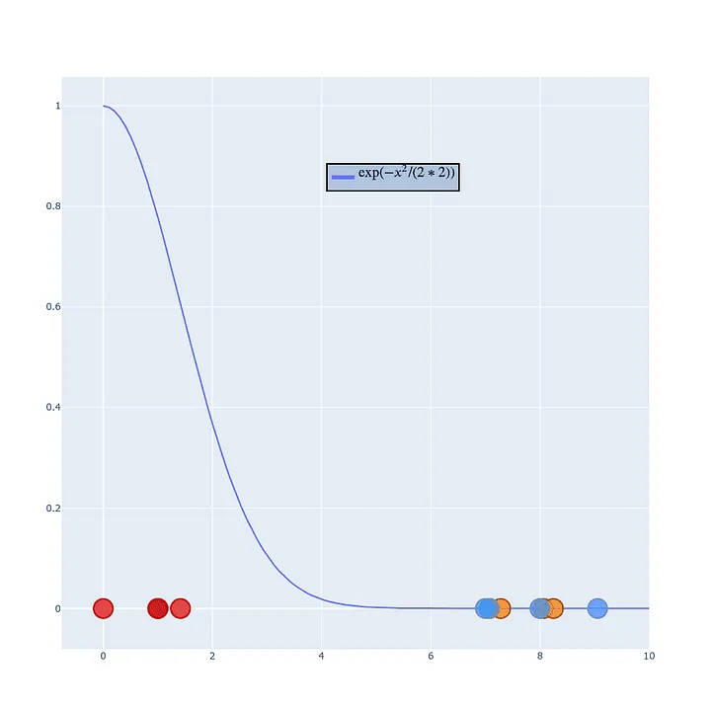
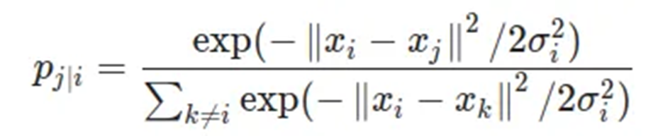

Slide 8
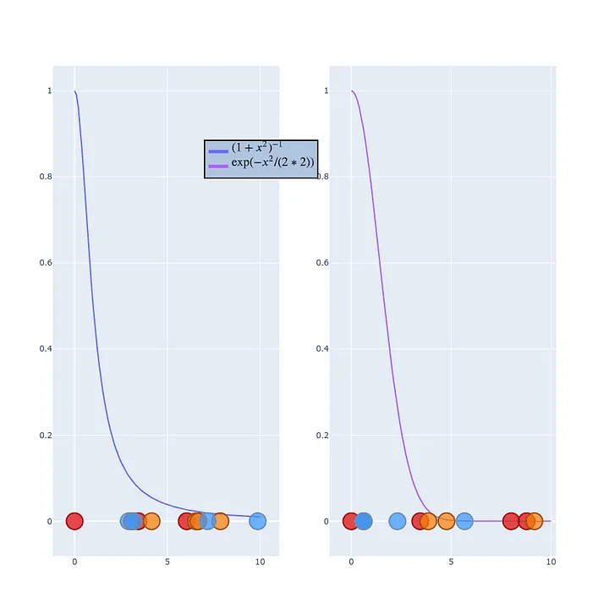

Student t-distribution

Slide 9

Gradient descent
Cost Function/Loss Function
Kullback-Leibler divergence

Slide 10
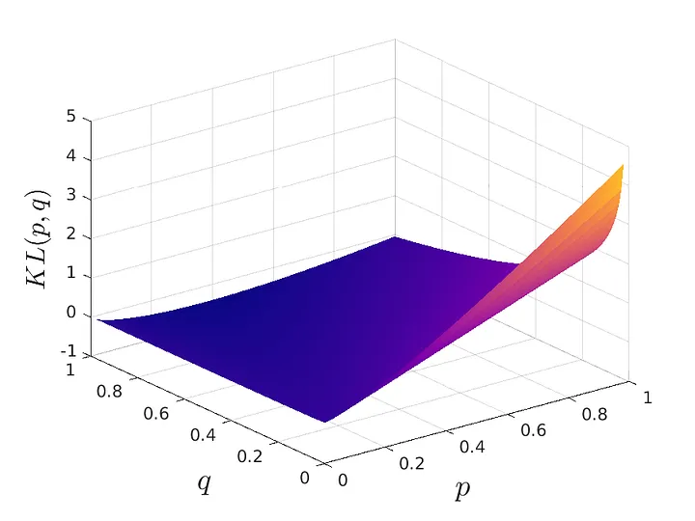
Gradient descent
A:
If two points are close together in high dimensional space, the probability p should be high (p ~ 1).
If they were mapped far away, the low dimensional probability would be low (q ~0).
In this scenario the loss function takes very high values, severely penalizing that mistake.
B:
If two points are far from each other in high dimensional space, the probability p should be low (p~0).
If they were mapped near each other, the low dimensional probability would be high (q~1).
he KL divergence is not penalizing this mistake as much as we would want. This is a key issue that will be solved by UMAP.
A
B
Near in 2D
Similar in n-D
https://towardsdatascience.com/visualizing-your-embeddings-4c79332581a9

Slide 11
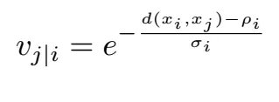
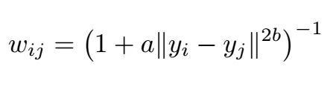
UMAP
Similarity in High Dimensional Space
Proximity in Low Dimensional Space
UMAP uses cross entropy as loss function
UMAP uses stochastic gradient descent

Slide 12
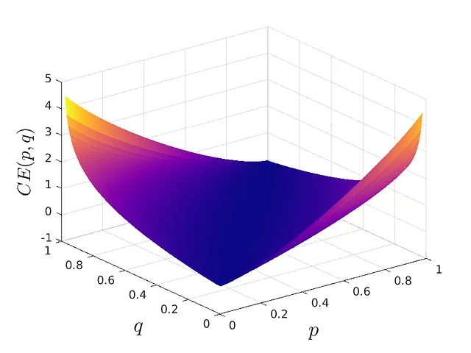
Loss Function: t-SNE vs UMAP
umap
t-SNE
Near in 2D
Similar in n-D
https://towardsdatascience.com/visualizing-your-embeddings-4c79332581a9

Slide 13
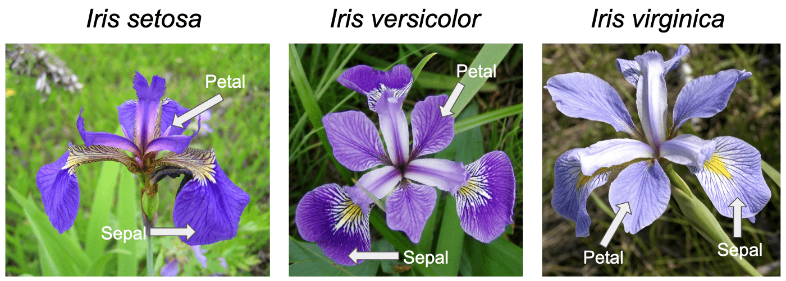
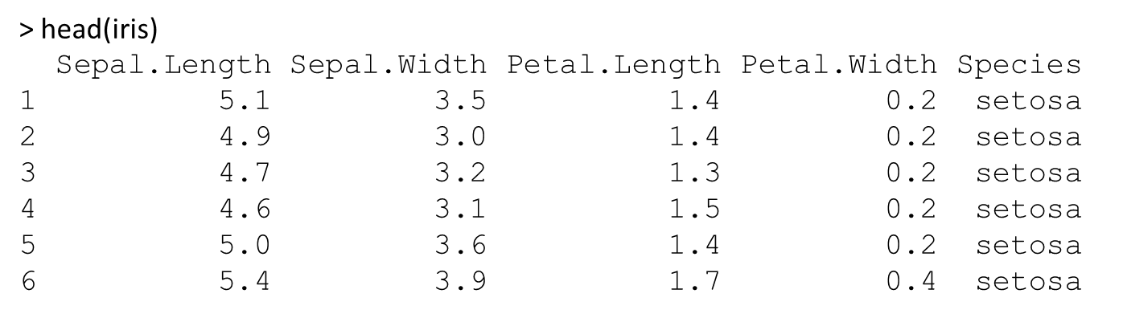
Data: iris

Slide 14
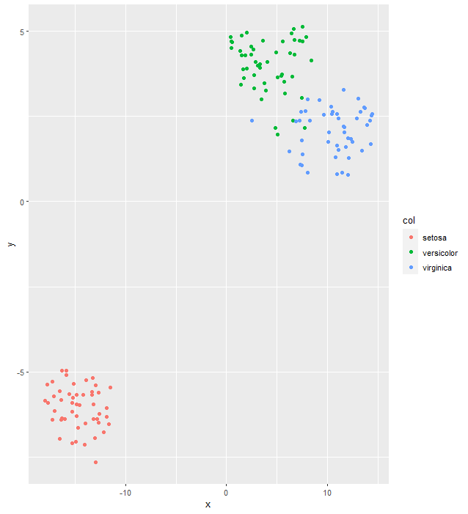
t-SNE
install.packages(“Rtsne”)
library(Rtsne)
iris_unique <- unique(iris)
iris_matrix <- as.matrix(iris_unique[,1:4])
set.seed(100)
tsne <- Rtsne(iris_matrix)
tsne_plot <- data.frame(x = tsne$Y[,1], y = tsne$Y[,2],
col = iris_unique$Species)
ggplot(tsne_plot) +
geom_point(aes(x=x, y=y, color=col))

Slide 15
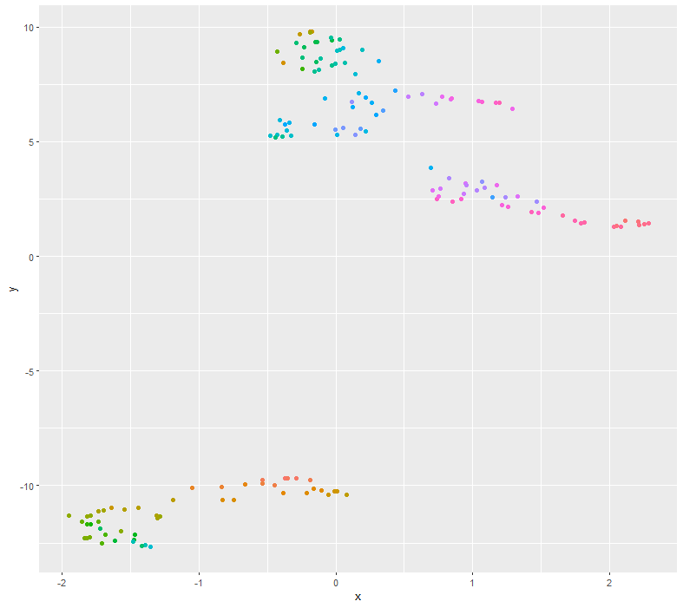
ggplot(df, aes(x, y, colour = colour)) +
geom_point(show.legend = FALSE)

Slide 16
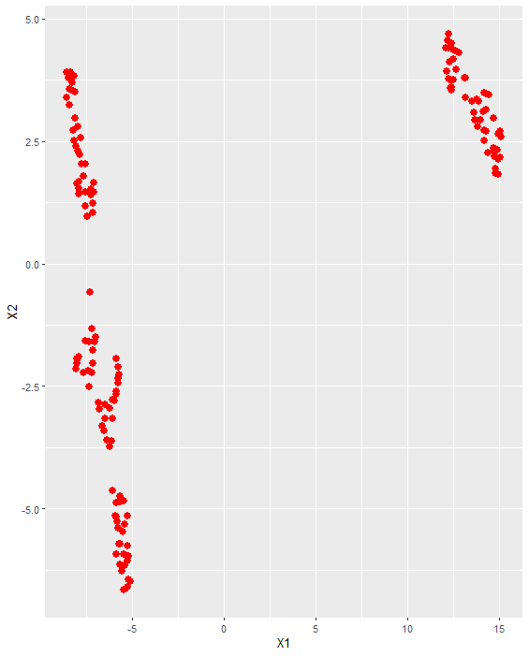
# Load required packages
library(umap)
library(ggplot2)
# Select features only, drop the Species column
iris.data <- subset(iris, select = -c(Species))
# set seed for stability
set.seed(100)
# Run UMAP to reduce the dimensionality of the data to 2 dimensions
UMAP: iris
umap_out <-umap(iris.data, n_components = 2)
umap_plot <-ggplot(data.frame(umap_out$layout),
aes(x=X1, y=X2)) +
geom_point(size=3, color='red')
umap_plot

Slide 17
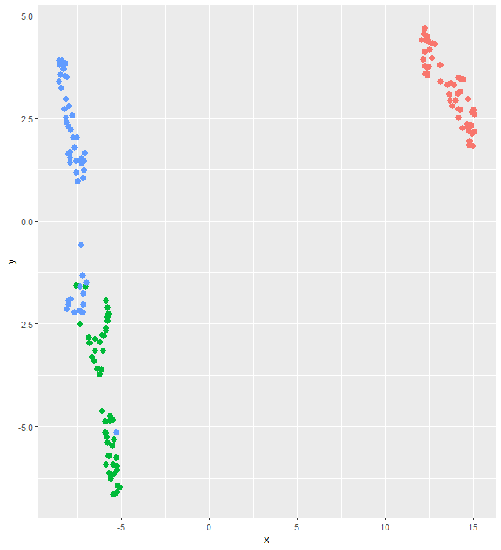
> df <- cbind.data.frame(setNames(as.data.frame(umap_out$layout), c("x", "y")), iris)
> head(df)
x y Sepal.Length Sepal.Width Petal.Length Petal.Width Species
1 13.99655 2.924492 5.1 3.5 1.4 0.2 setosa
2 12.33640 3.584819 4.9 3.0 1.4 0.2 setosa
3 12.29551 4.115737 4.7 3.2 1.3 0.2 setosa
4 12.54009 4.168110 4.6 3.1 1.5 0.2 setosa
5 14.27660 3.133241 5.0 3.6 1.4 0.2 setosa
6 14.90303 2.328493 5.4 3.9 1.7 0.4 setosa
umap_plot <-ggplot(df, aes(x=x, y=y, color=Species))
+geom_point(size=3)
+ theme(legend.position="none")
umap_plot

Slide 18
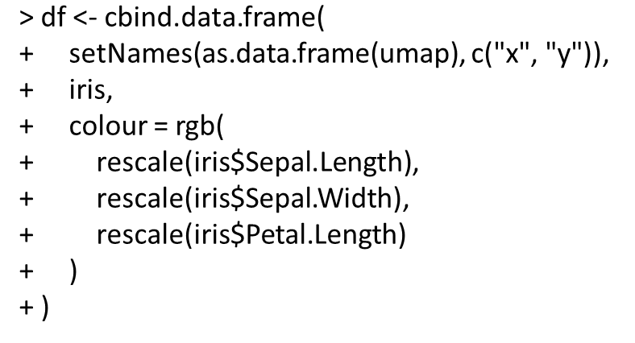

Slide 19
> head(df)
x y Sepal.Length Sepal.Width Petal.Length Petal.Width Species colour
1 -1.95430794 -11.318177 5.1 3.5 1.4 0.2 setosa #399F11
2 -0.01048949 -10.265982 4.9 3.0 1.4 0.2 setosa #2B6A11
3 -0.66297176 -9.953050 4.7 3.2 1.3 0.2 setosa #1C800D
4 -0.44592753 -9.987502 4.6 3.1 1.5 0.2 setosa #157516
5 -1.70084467 -11.075300 5.0 3.6 1.4 0.2 setosa #32AA11
6 -1.61857214 -12.399263 5.4 3.9 1.7 0.4 setosa #4ECA1E

Slide 20
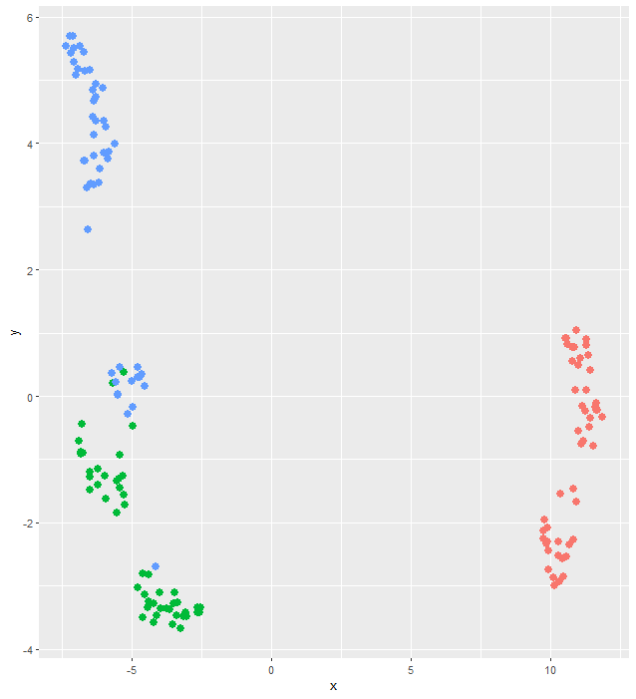
#UMAPset.seed(100)
umap_out <-umap(iris.data, n_components = 2)
df <- cbind.data.frame(setNames(as.data.frame(umap_out$layout), c("x", "y")), iris)
umap_plot <-ggplot(df, aes(x=x, y=y, color=Species))+geom_point(size=3)+ theme(legend.position="none")
umap_plot

Slide 21
Filters
penguins <- penguins %>% drop_na() %>% select(-year) %>% mutate(ID=row_number())

Slide 22
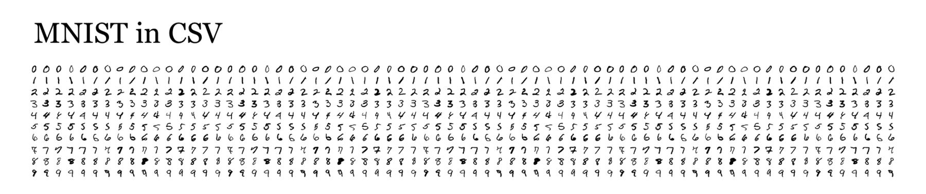
Data: MNIST

Slide 23
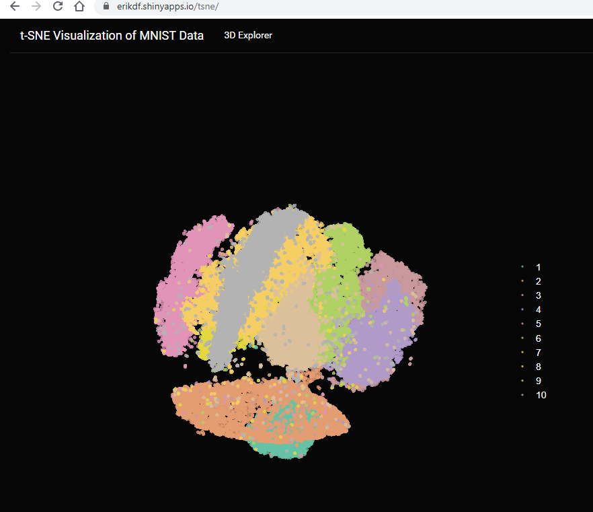
https://erikdf.shinyapps.io/tsne/

Slide 24
Barnes-Hut implementation of t-Distributed Stochastic Neighbor Embedding
Wrapper for the C++ implementation of Barnes-Hut t-Distributed Stochastic Neighbor Embedding. t-SNE is a method for constructing a low dimensional embedding of high-dimensional data, distances or similarities. Exact t-SNE can be computed by setting theta=0.0.
Usage
Rtsne(X, ...)
## Default S3 method:
Rtsne(
X,
dims = 2,
initial_dims = 50,
perplexity = 30,
theta = 0.5,
check_duplicates = TRUE,
pca = TRUE,
partial_pca = FALSE,
max_iter = 1000,
verbose = getOption("verbose", FALSE),
is_distance = FALSE,
Y_init = NULL,
pca_center = TRUE,
pca_scale = FALSE,
normalize = TRUE,
stop_lying_iter = ifelse(is.null(Y_init), 250L, 0L),
mom_switch_iter = ifelse(is.null(Y_init), 250L, 0L),
momentum = 0.5,
final_momentum = 0.8,
eta = 200,
exaggeration_factor = 12,
num_threads = 1,

Slide 25
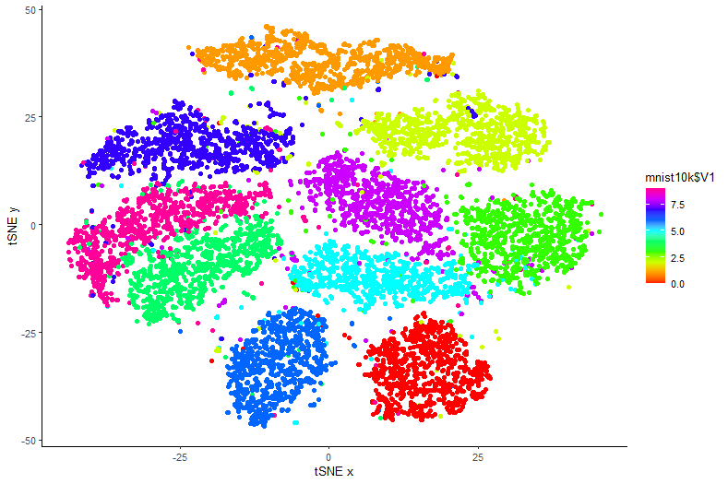
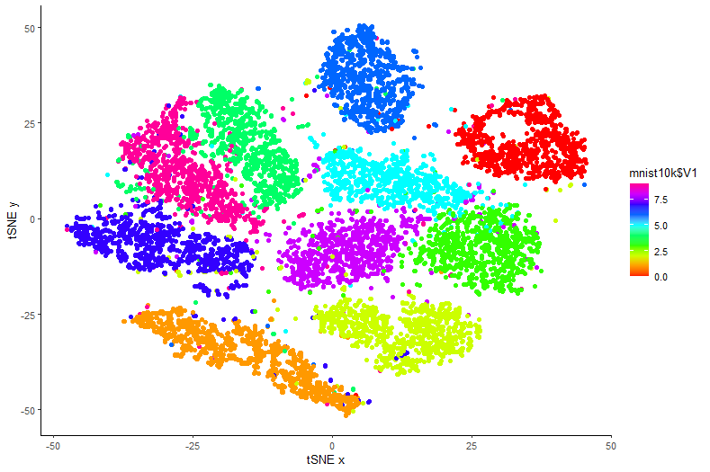
MNISt with t-SNE
install.packages("tidyverse")
library(tidyverse)
install.packages("Rtsne")
library(Rtsne)
mnist10k <- read.csv("D://Drexel//Teaching//INFO250//week7//datasets//D1_mnist_10000.csv", header = FALSE)
# class(mnist10k)
# [1] "data.frame“
# mnist10k$V1 is the key
mnist10k_data <- subset(mnist10k, select=c(2:785))
set.seed(42)
tsne_out <- Rtsne(mnist10k_data)
tsne_plot <- data.frame(x = tsne_out$Y[,1], y = tsne_out$Y[,2])
ggplot(tsne_plot, aes(x = x, y=y, color=mnist10k$V1)) +
geom_point() +
scale_color_gradientn(colors=rainbow(10)) +
labs(x = "tSNE x", y="tSNE y") + theme_classic()
labels <- as.character(mnist10k$V1)
ggplot(tsne_plot, aes(x = x, y=y, color=labels)) +
geom_point() +
scale_color_discrete() +
+ labs(x = "tSNE x", y="tSNE y") + theme_classic()

Slide 26
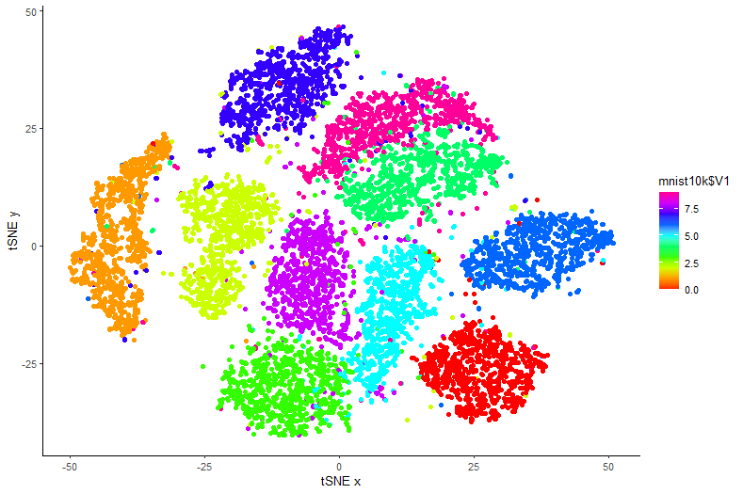
Why set random seed to 42?
What is the significance of random. seed(42) ? It's a pop-culture reference! In Douglas Adams's popular 1979 science-fiction novel The Hitchhiker's Guide to the Galaxy, towards the end of the book, the supercomputer Deep Thought reveals that the answer to the great question of “life, the universe and everything” is 42.

Slide 27
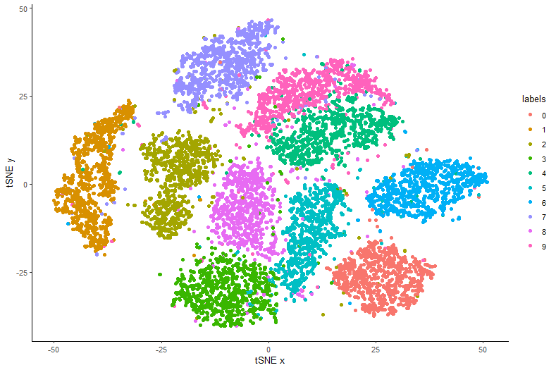
labels <- as.character(mnist10k$V1) aes(x = x, y=y, color=labels) scale_color_discrete()

Slide 28
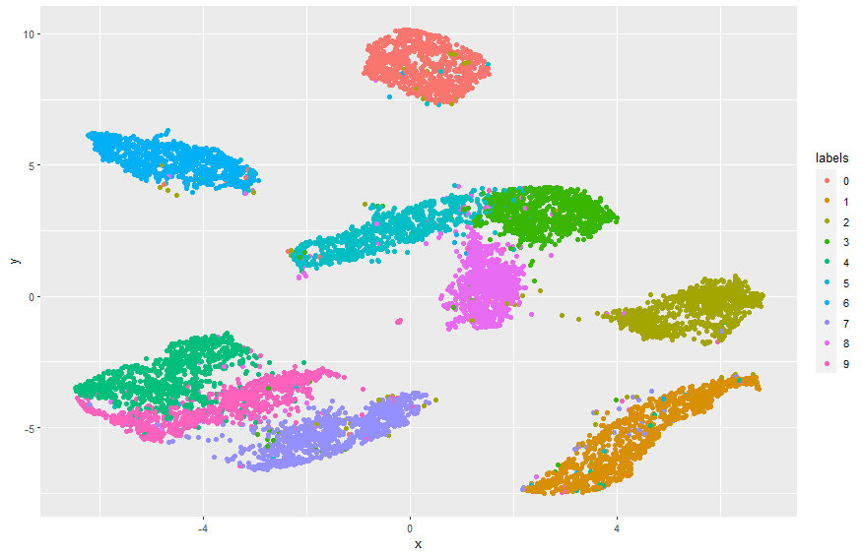
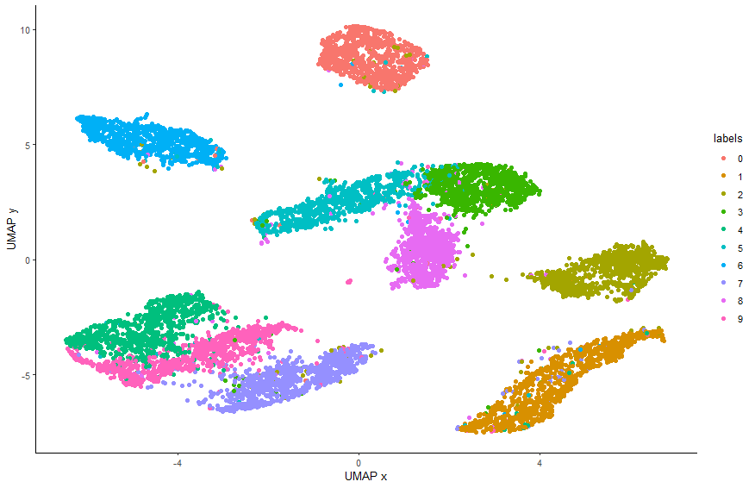
labs(x = "UMAP x", y="UMAP y")
theme_classic()

